Slide 1
Database Setup
Brandon Laufer

Slide 2
Objective
Find relationships between peptide sequences
Faster searching of sequences
All data in one area and not on thousands of spreadsheets
Find duplicate sequences
Track all peptides tested

Slide 3
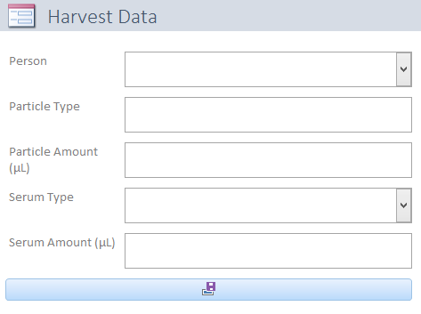

Access Forms
Allow for input to spreadsheets
Keeps all data in the same format
Uses dropboxes
States units
VBA Code

Slide 4
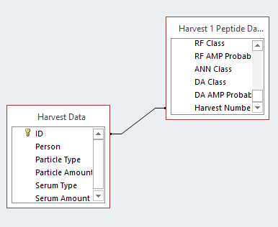
Relationships
ID of Harvest Data
Connects to Harvest Number

Slide 5
Issues
VBA
Unfamiliar with Access VBA
Input spreadsheets
Have about 25 lines of header that automatic input cannot process
Need to add a column that creates the relationship automatically
Users
Create file telling what each user input
Only allowing each user to access/change certain things

